Slide 1
Academic Integrity
Academic Integrity should be maintained
  Assignments, Term Papers, Mid-term, Term Project, and Final Examination
Dept. Policy on Academic Misconduct
  https://www.csa.iisc.ac.in/newweb/wp-content/uploads/2020/10/misconduct_guidelines.pdf
Followed in this course:
  ·Zero marks: All students (who are involved in copying) receives zero marks for the entire assignment/exam/etc.
  One grade Penalty: If a student is charged with misconduct for the second time in the course, additionally one-grade penalty will be awarded

Slide 2
L4 – Performance Evaluation

Slide 3
Performance Evaluation
Measurement
  Hardware Performance Counters
  Profiling tools
  Off-chip and software monitoring
Modeling: Simulation
  Trace driven vs. Execution driven
  Functional simulators vs. performance simulators
Modeling: Analytical models
  Queuing, Petri net, Regression Model, …

Slide 4
Performance Measurement
On real/existing systems
  Basic time measurement using TSC
  Profiling tools
  Hardware Performance Counters
Time measurements
  using time command
  gettimeofday
  getrusage,
  high resolution timers gethrtime

Slide 5
Profiling
Profiler: tool that helps you identify the `important’ parts of your program to concentrate your optimization efforts
Profile: breakup (of execution time) across different parts of the program
  function, basic-block, statement-levels
Can be done by adding statements to your program (instrumentation) -- so that during execution, data is gathered, outputted
  execution time and execution count
PC value is sampled (once every clock tick, default: 10 msec); triggered on timer interrupt
prof, gprof, …
Notes:
L19

Slide 6
Performance Counters
Performance Monitoring Counters – count various events
  More than 200 events; Can vary from processor to processor
  Some fixed and some programmable counters
  PMC: Can measure a few (~4) events in a single run
  Counter values can be read using RDPMC instrn.
Tools on top of PMC
  PAPI, Perf, Vtune, …

Slide 7
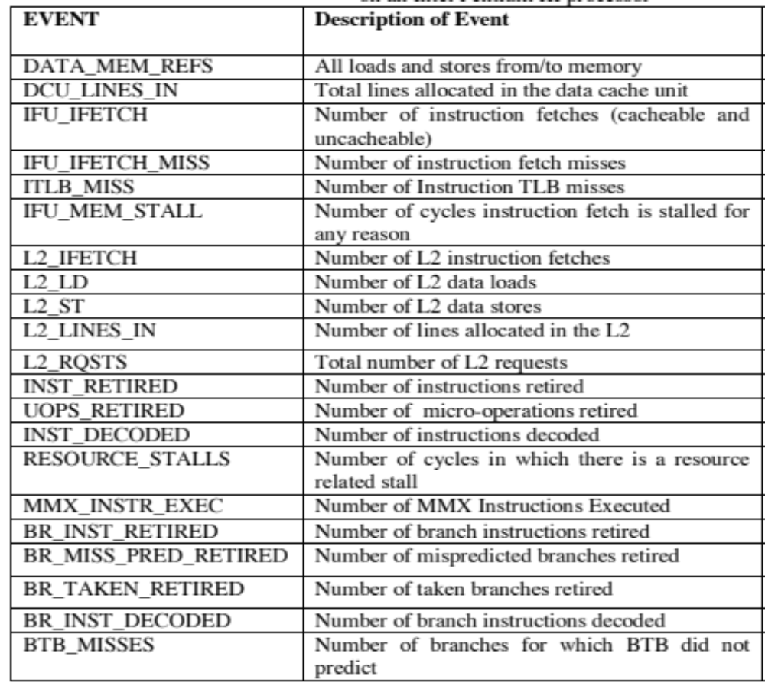
Performance Counter Events

Slide 8
Modeling: Architecture Simulators
What is an architectural simulator?
  a tool that reproduces the behavior of a computing device
Why we use a simulator?
  Leverage a faster, more flexible software development cycle
    Permit more design space exploration
    Facilitates validation before H/W becomes available
    Level of abstraction is tailored by design task
    Possible to increase/improve system instrumentation
    Usually less expensive than building a real system
Flexibility vs Performance vs Details

Slide 9
Functional vs. Performance
Functional simulators implement the architecture.
  Perform real execution
  Implement what programmers see
Performance simulators implement the microarchitecture.
  Concern about time (cycle accurate)
  Model system resources/internals (microarchitecture resources)
  Simulator state is microarchitecture state
Notes:
I mentioned in previous slide that simplescalar is highly flexible since it provide both functional and performance simulators.
Functional simulators:
Ex, for a branch predictor, you care more about the prediction accuracy than the actual timing
for example, memory and registers are visible resources to a programmer using assembly language
Performance simulators: programmers cannot see how an instruction is transmitted. However, the transmitting process is important for performance evaluation

Slide 10
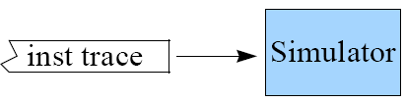
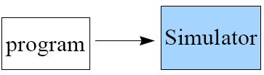
Trace- vs. Execution-Driven
Trace-Driven
  Simulator reads a ‘trace’ of the instructions captured during a previous execution
  Easy to implement, no functional components necessary
  Dinero, ZSim, …
Execution-Driven
  Simulator runs the program (trace-on-the-fly)
  Hard to implement
  Advantages
    Faster than tracing
    No need to store traces
    Register and memory values usually are not in trace
    Support mis-speculation cost modeling
  Simplescalar, Gem5, …
Notes:
One thing I want to point out is that a simulator can both be an execution driven and a performance simulator.

Slide 11
SimpleScalar Simulator
Compiled from SimpleScalar Tutorial
by Prof. Ali Agoklu
Univ. of Arizona

Slide 12
Simulators
Around 40 simulators listed at http://www.cs.wisc.edu/arch/www/tools.html
SimpleScalar (uni-processor, superscalar)
  Developed by Todd Austin while in U of Wisconsin-Madison
  Widely used in the academia and industry

Slide 13
Advantages of SimpleScalar
Highly flexible
  functional simulator + performance simulator
Portable
  Host: virtual target runs on most Unix-like systems
  Target: simulators can support multiple ISAs
Extensible
  Source is included for compiler, libraries, simulators
  Easy to write simulators
Performance
  Runs codes approaching ‘real’ sizes

Slide 14
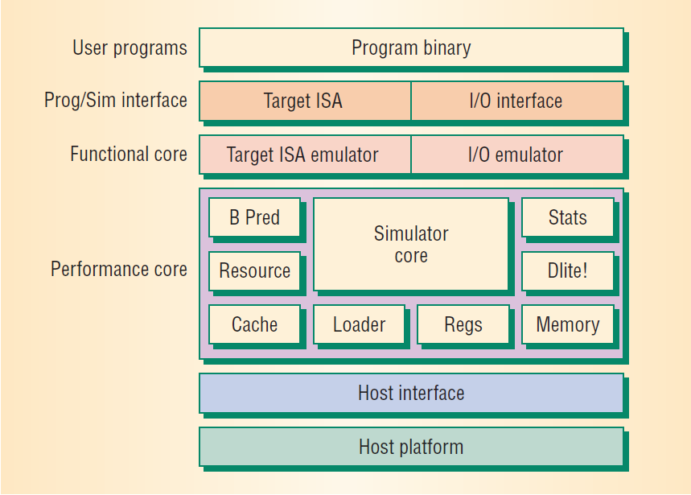
Simulator Software Architecture

Slide 15
Simulator Suite
Sim-Fast
(7 MIPS)
Sim-Safe
(6 MIPS)
Sim-Profile
Sim-Cache
Sim-BPred
Sim-Outorder
(0.3 MIPS)
300 lines
functional
No timing
350 lines
functional w/checks
900 lines
functional
Lot of stats
< 1000 lines
functional
Cache stats
Branch stats
3900 lines
performance
OoO issue
Branch pred.
Mis-spec.
ALUs
Cache
TLB
200+ KIPS
Performance
Detail

Slide 16
Sim-Fast
Functional simulation
Optimized for speed
Assumes no cache
Assumes no instruction checking
Does not support Dlite (source level target program debugger, .h, .c )!
Does not allow command line arguments
<300 lines of code

Slide 17
Sim-Cache
Cache simulation
Ideal for fast simulation of caches (if the effect of cache performance on execution time is not necessary)
Accepts command line arguments for:
  level 1 & 2 instruction and data caches
  TLB configuration (data and instruction)
  Flush and compress
  and more
Ideal for performing high-level cache studies that don’t take access time of the caches into account

Slide 18
Sim-Bpred
Simulate different branch prediction mechanisms
Generate prediction hit and miss rate reports
Does not simulate the effect of branch prediction on total execution time
  nottaken
  taken
  perfect
  bimod bimodal predictor
  2lev 2-level adaptive predictor
  comb combined predictor (bimodal and 2-level)

Slide 19
Sim-Outorder
Most complicated and detailed simulator
Supports out-of-order issue and execution
Provides reports
  branch prediction
  cache
  external memory
  various configuration

Slide 20
Sim-Outorder HW Architecture
Fetch
Dispatch
Register
Scheduler
Exe
Writeback
Commit
Memory
Scheduler
Mem
I-Cache
I-TLB
D-Cache
D-TLB
Virtual Memory

Slide 21
Sim-Outorder (Main Loop)
sim_main() in sim-outorder.c
      ruu_init();
      for(;;){
      ruu_commit();
      ruu_writeback();
      lsq_refresh();
      ruu_issue();
      ruu_dispatch();
      ruu_fetch();
      }
Executed once for each simulated machine cycle
Walks pipeline from Commit to Fetch
  Reverse traversal handles inter-stage latch synchronization by only one pass

Slide 22
Effects of OS
System call exec. time (especially in transaction-oriented processing, web server which involve significant OS interaction)
In multi-core system, scheduling of processes across cores
OS maintained structures and their impact?
Sharing hardware structures betn. kernel and user processes and their impact on performance

Slide 23
Simulation Methodology
OS Effect
  System call emulation or full-system simulation?
Benchmark programs used
Baseline configuration used
Input for benchmark programs
Simulate program till?
Performance metrics
  Execution cycles, CPI or IPC, Cache misses, branch prediction, …

Slide 24
Benchmarks Suites
Different Benchmark suites
  SPEC Int, SPEC FP (1992, 1995, 2000, 2006, 2017)
  TPC
  Datacentre: Cloudsuite
  MEDIABENCH, MIBENCH
  PARSEC, PARBOIL, RODINIA, …
  Multithreaded vs. Multiprogramed
Use one or more benchmark suites
Subset of a suite?
  Rigorous statistical methods for choosing a subset?

Slide 25
Benchmark Input Used
SPEC programs have
  Test, Train, Reference
Reduced Input for SPEC
  Representative input retaining the characteristics
  What is included in characteristic?
    Inst. Mix, Freq. of Branches, Cache/memory behavior, basic block freq.?
  MinneSPEC [KleinOsowskiLilja, 2002]

Slide 26
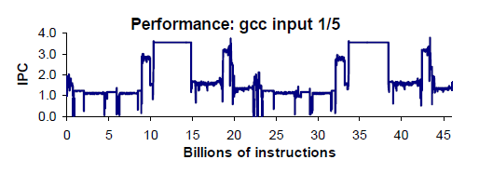
Simulation Methodology
Simulate till the end of the program
Simulate first Z million instruction (Run Z)
Fast forward X million and run Z million instructions (FF X + Run Z)
Fast forward X million, warm up for Y million, and then run Z million instructions (FF X + WU Y + Run Z)
Other methods for reducing the simulation time?
  Simpoint, SMARTS, …

Slide 27
Performance Metrics
Execution cycles
CPI or IPC
  Cache misses, branch prediction, …
Power, Energy Dissipated, …
  Wattch, SimplePower, ...
Speedup, Weighted Speedup, ANTT, …
  Multicore, Multithreaded, Multiprogrammed,

Slide 28
Analytical Modeling
Slides from
Prof. Matthew Jacob, CSA

Slide 29
Architecture Evaluation Challenges
Skadron, Martonosi, August, Hill, Lilja and Pai, IEEE Computer, Aug 2003
“Quantitative evaluation is the mainstay
There has been a dramatic shift towards simulation
But system complexity makes it troublesome”

Slide 30
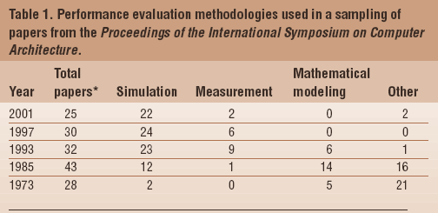
Simulation: Preferred Tool

Slide 31
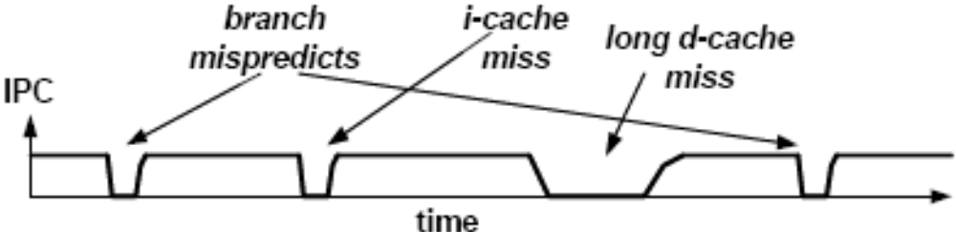
What about analytical models?
Example: Karkhanis and Smith, A First-order Model of Superscalar Processors, 31st ISCA 2004
  Analytical model for estimating superscalar processor program CPI (Cycles per Instruction)

Slide 32
What about analytical models?
Example: Karkhanis and Smith, A First-order Model of Superscalar Processors, 31st ISCA 2004
  Analytical model for estimating superscalar processor program CPI
  5.8% average error
  Uses “expert knowledge”

Slide 33
What is Empirical Modeling?
Extracting models from measured data
  We can use simulators to generate the data
Linear models
Ease of Interpretation
Neural nets
Prediction accuracy

Slide 34
Modeling Out-of-order Superscalars
(P. J. Joseph, Kapil Vaswani)
Build models to help understand the relative importance of design parameters and also of their interactions
  The first (and still only) systematic approach available
Build an accurate predictive model
  The first (and still most efficient) predictive modeling technique available
Demonstrate the use of such models

Slide 35
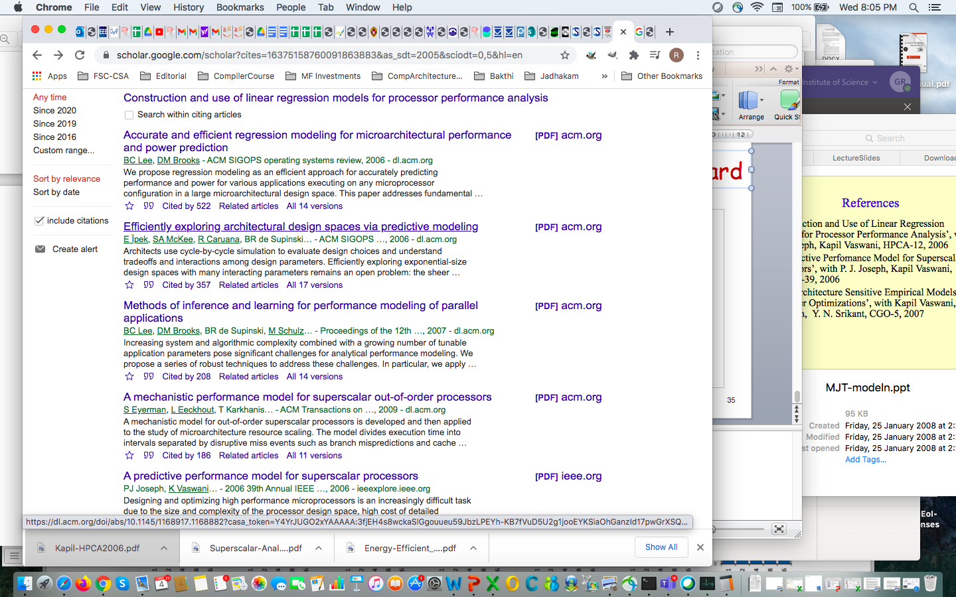
Analytical Model: Moving forward

Slide 36
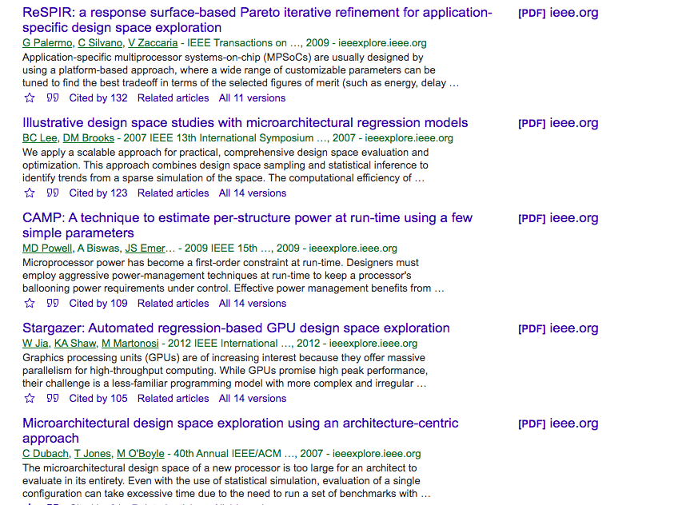
Analytical Model: Moving forward

